Slide 1
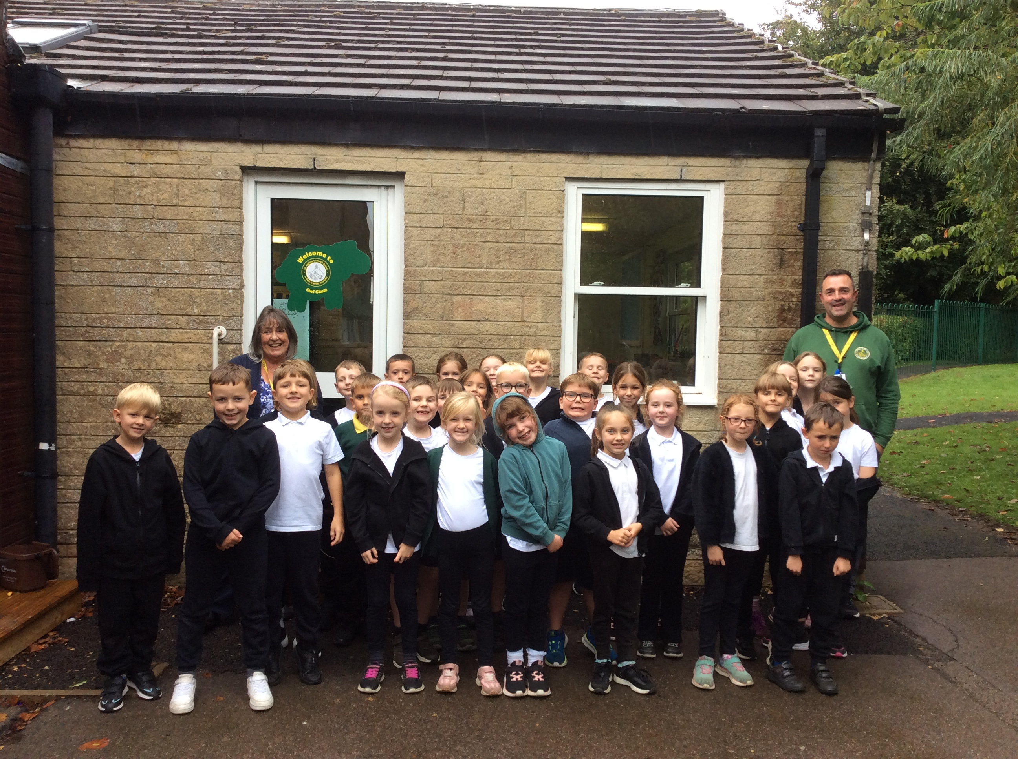
Welcome to Owls
(Year 3)

Slide 2
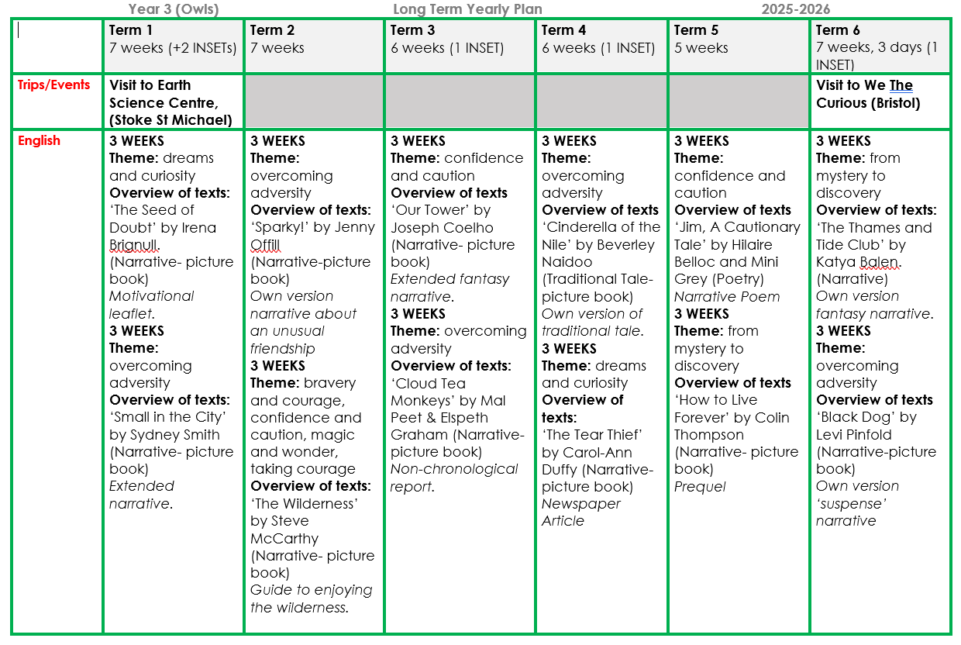
Our Learning

Slide 3
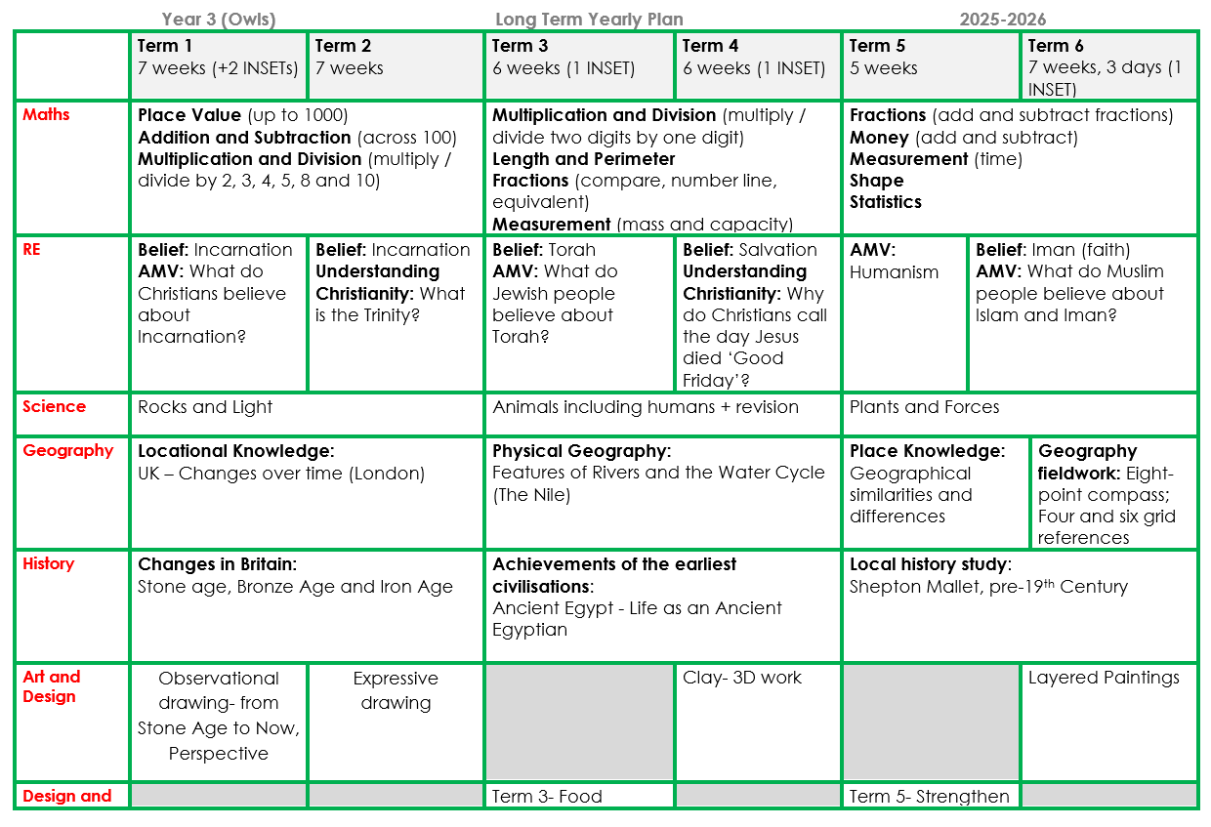
Our Learning

Slide 4
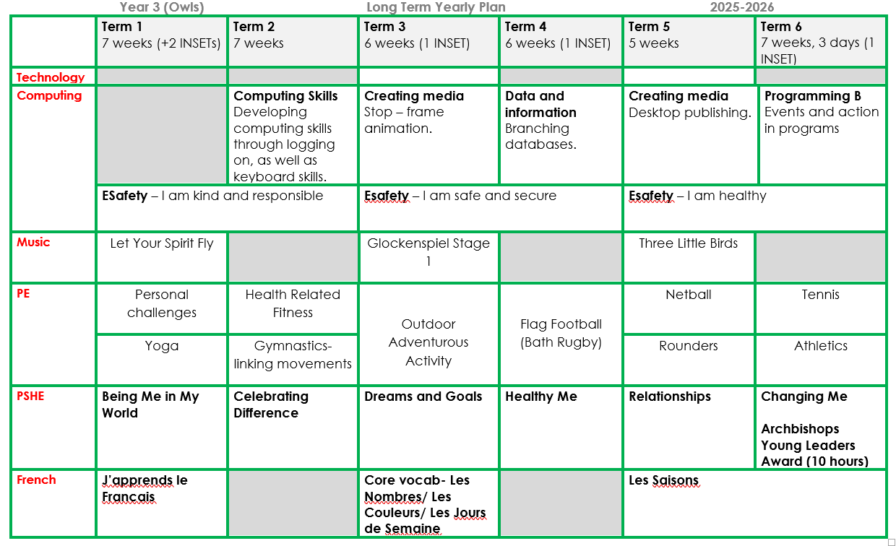
Our Learning

Slide 5

Any questions?

Slide 6
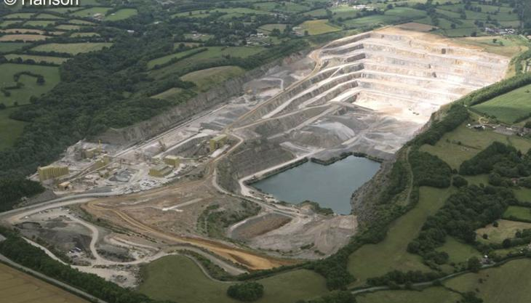
Experiences
Thursday 18th September
Rock testing, fossils and Quarry tour
(it should be a real blast!)

Slide 7




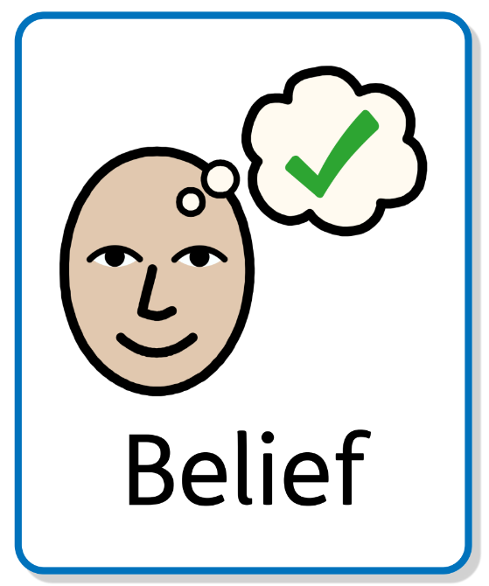


Class Dojo
Points awarded for above and beyond
Our 3 School Rules
Ready | Respectful | Safe
Our Learning Behaviours
Belief | Aspiration | Advocacy
We will continue to add information and share the great work your children do on Class Story as well as on the class page on the website.

Slide 8
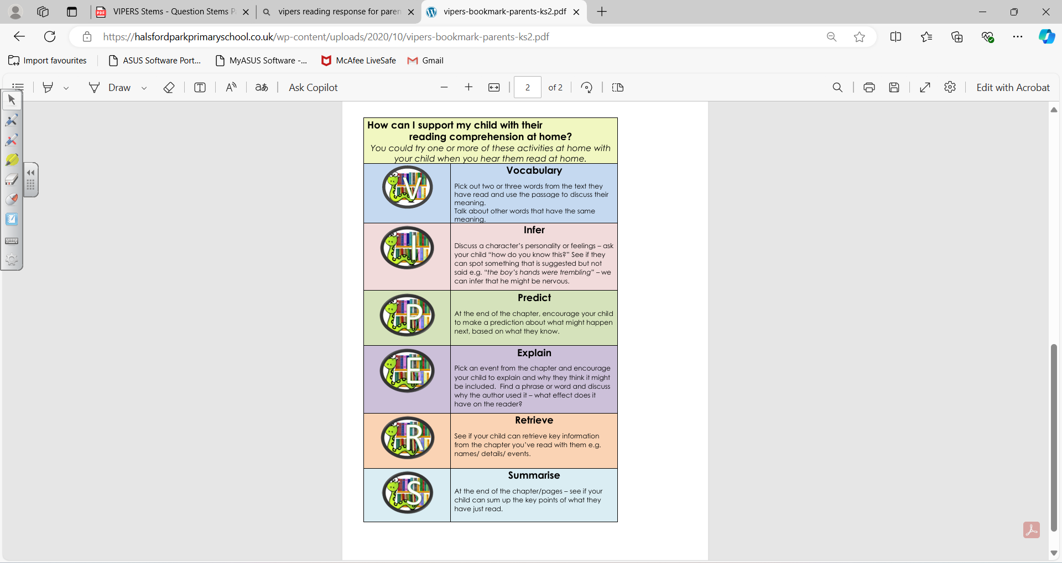
Reading Response
What do we mean by Reading Response?

Slide 9
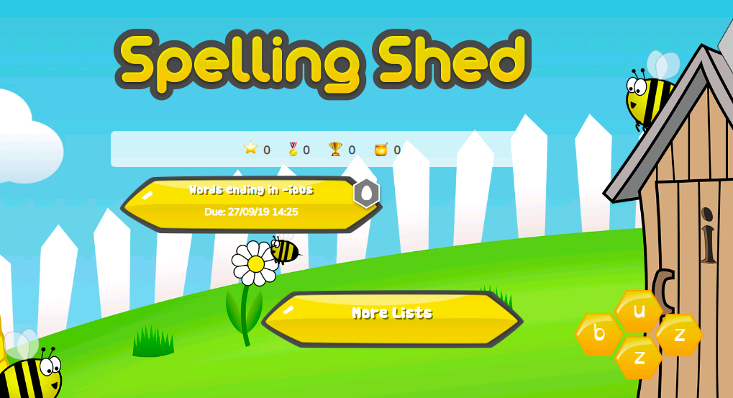
Spelling Shed
The children are set 15 minutes across the week
(6 games).
Remember there are BUZZ and HIVE games that can be played in addition.

Slide 10
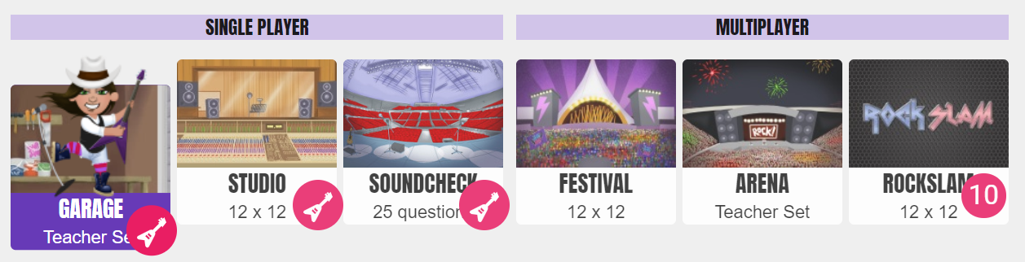
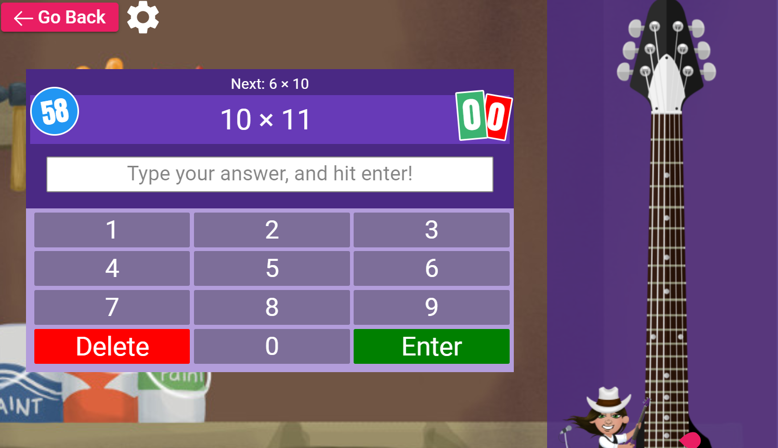
Times Tables Rockstars
Garage
The children are set15 minutes a week. They can do more than this if they wish, as it will help their fluency and application across Maths.

Slide 11
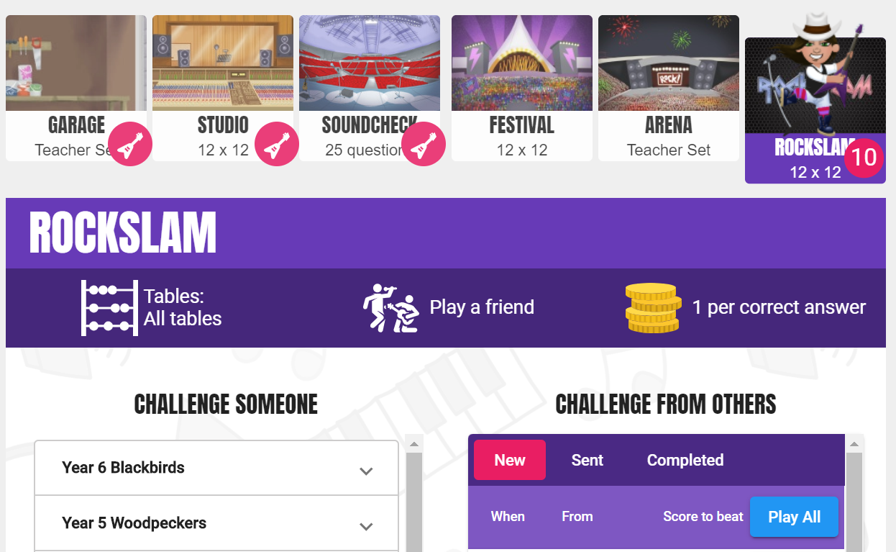
Times Tables Rockstars
Rockslam
This is where children can challenge someone (pupils and teachers across the school) or complete a challenge set by someone else.

Slide 12
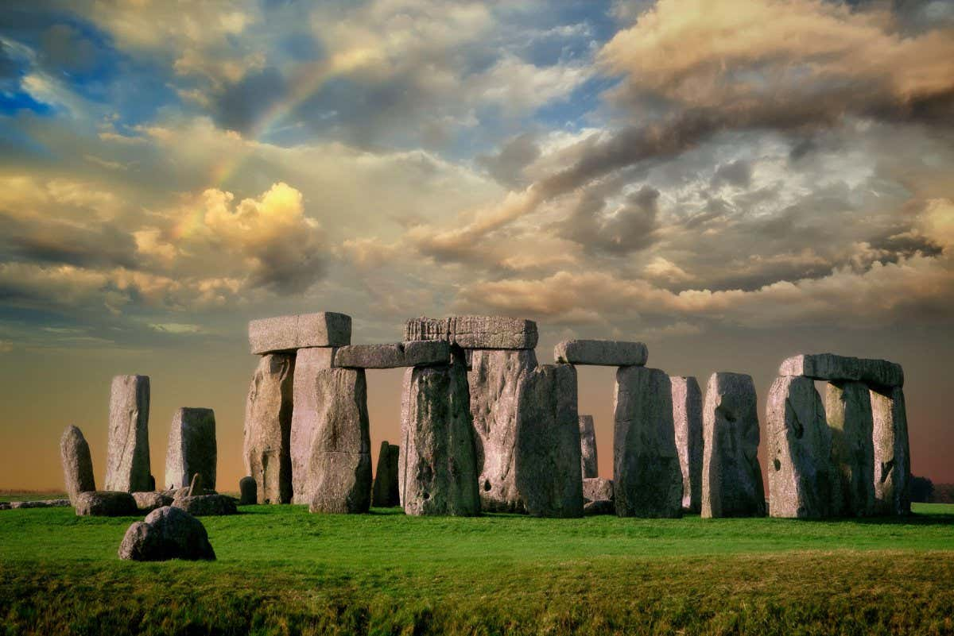
Creative Projects
From our learning, across a range of subjects.
Different skills.
3 Dojo pts per week, with TT Rock Stars and Spelling Shed.

Slide 13
Extra Information
PE – Tuesday morning and Wednesday afternoon (we will have indoor sessions in Term 1 as it is Personal Challenges and Yoga!)
Wellies – please can children bring in named wellies to keep in school so that children can go in our designated Forest School area, when timetabled.
Snack – please make sure children bring in healthy snacks for break time (fruit or veg).
Coat – please make sure this is in each day.
For any messages that you want to share, especially ones that relate to the same day, please ring the School Office. I try to check emails and Class Dojo regularly, but this will not happen during teaching time.

Slide 14
Any questions?

