Slide 1



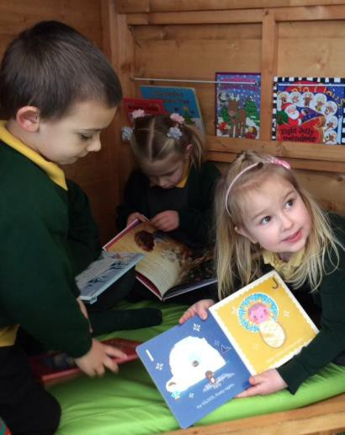

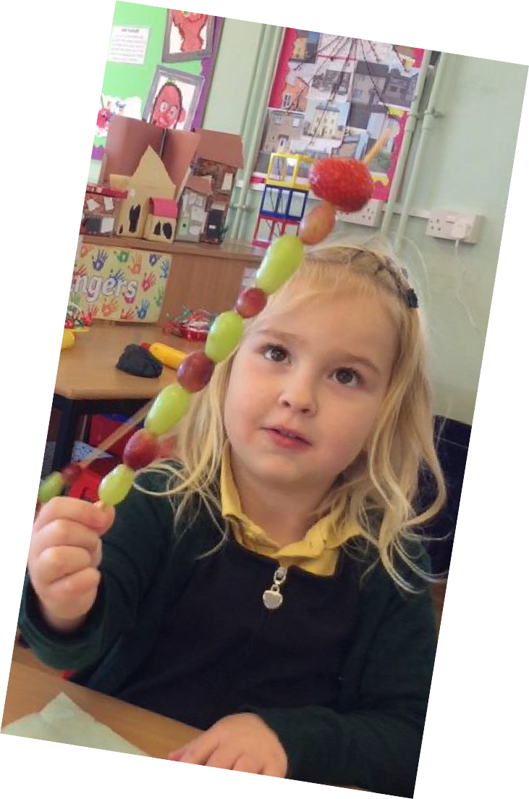
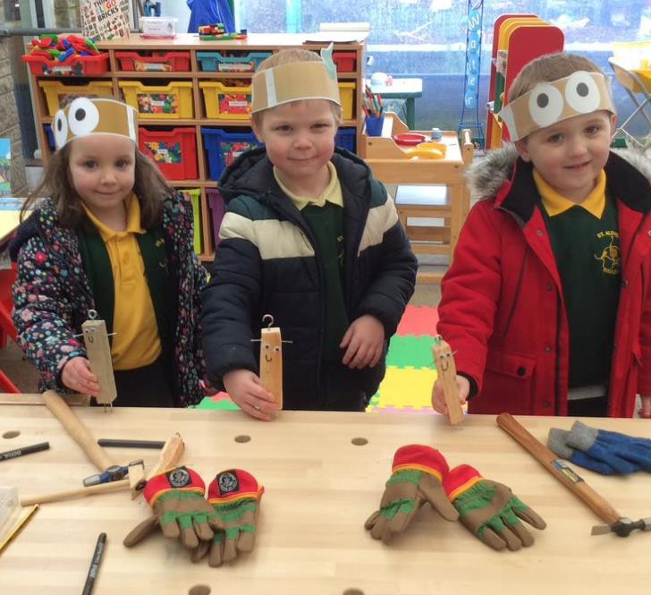
Welcome to
St Aldhelm’s VA Church Primary School
Presentation for new Reception families

Slide 2

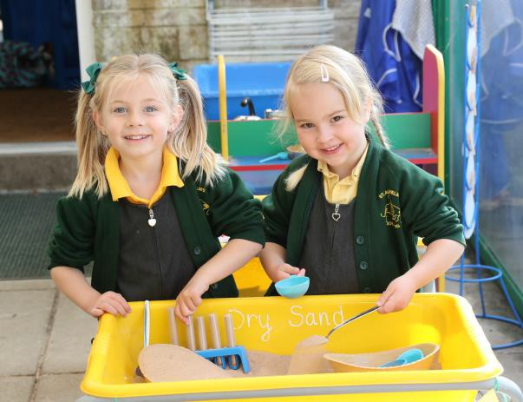
Welcome to St Aldhelm’s Presentation: New Reception Parent Induction
Dear Parents and Children
We hope you enjoy sharing this presentation together to find out more about your new school, particularly life in the Reception Robins Class. The slides will take you through the routines, expectations and how we hope to work with you in helping your child grow as a happy, confident and curious learner.
Click on the picture to watch the virtual tour of your new school on our website – make sure you scroll down the page as the link is towards the bottom

Slide 3


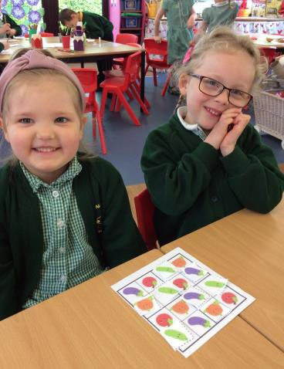

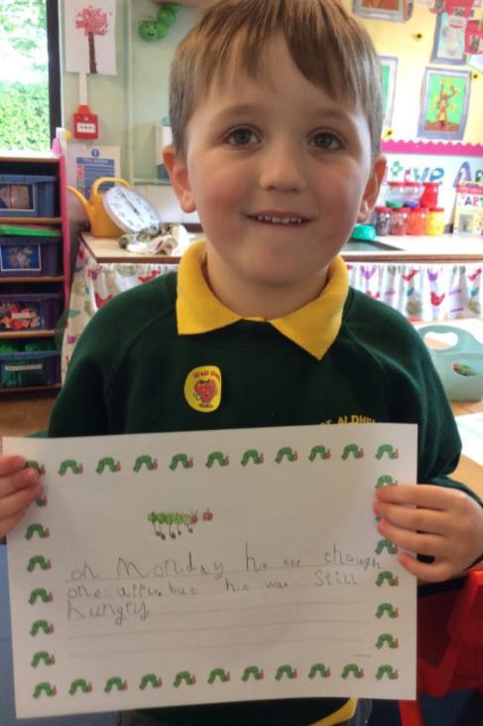
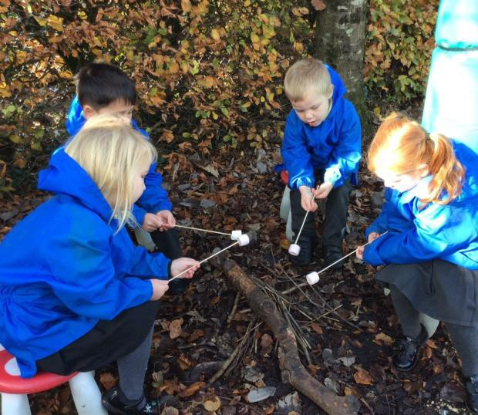
The Early Years Foundation Stage Curriculum
Your child will be learning through the Early Years Foundation Stage
Curriculum. This is abbreviated to EYFS. It is the stage of education
for children from birth to the end of the Reception year.
Provision in Reception builds on what children have been learning in
nursery or pre-school settings.

Slide 4


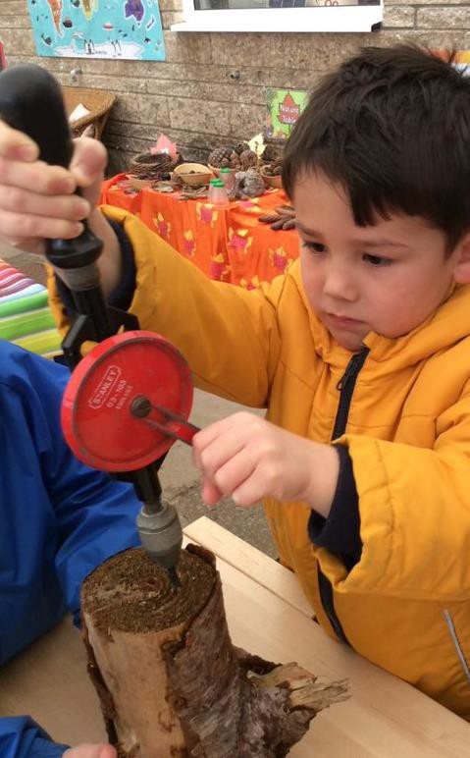
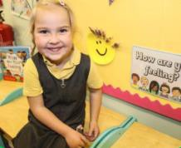


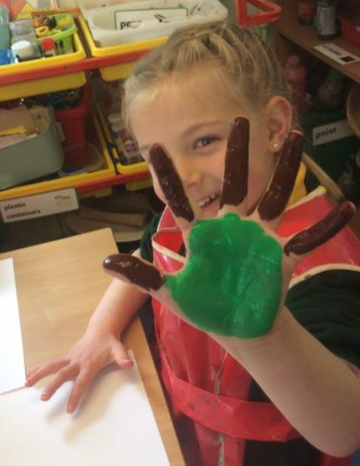
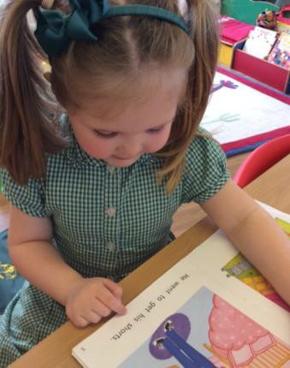
EYFS – Structure of the Curriculum
The EYFS comprises of three prime areas of learning and four specific areas of learning. It is recognised that children need to be secure in the prime areas for learning in other areas to be accelerated.
Prime Areas of Learning
Communication and Language
Physical Development
Personal, Social and Emotional Development
Specific Areas of Learning
Literacy Mathematics
Understanding the World
Expressive Arts and Design

Slide 5


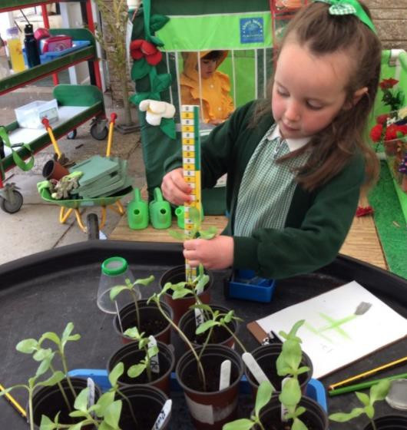
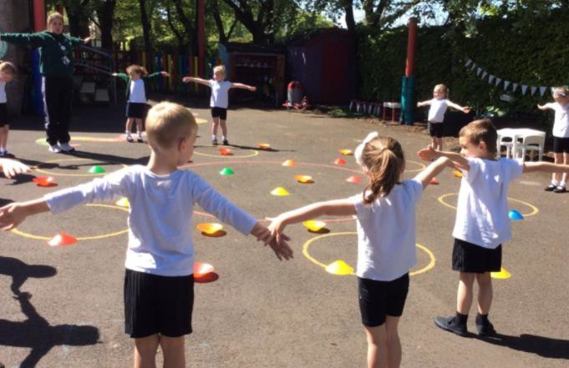
What learning looks like in practice
Learning is delivered through a balance of adult led and child initiated
experiences and activities centred around play and active learning.
Let’s have a look at a ‘typical’ school day to see how this works.

Slide 6

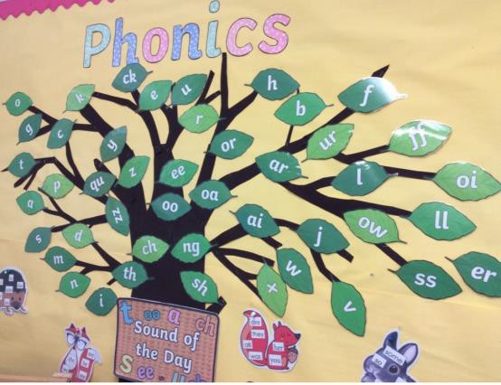
The School Day
Routines and structure are gradually introduced as part of the settling in process.
Self register
Day of the week
Track time
Phonics
Group Time activities – For example:
Phonics/writing, Fine motor skills, Guided reading, Number, Creative.
Independent Learning Time
Forest School and Outdoor learning Time
Lunch Time
Group Time activities or specialist area of learning – PSHE, PE, RE, Music.
Play Time
Snack Time and Story Time
Home Time

Slide 7

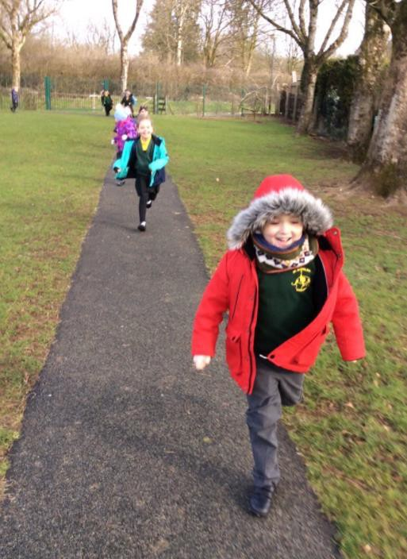

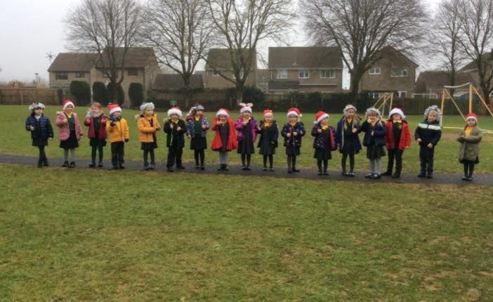


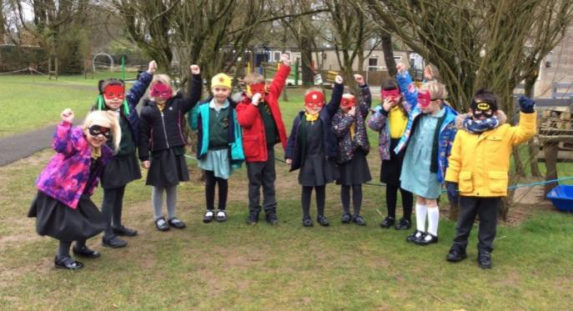
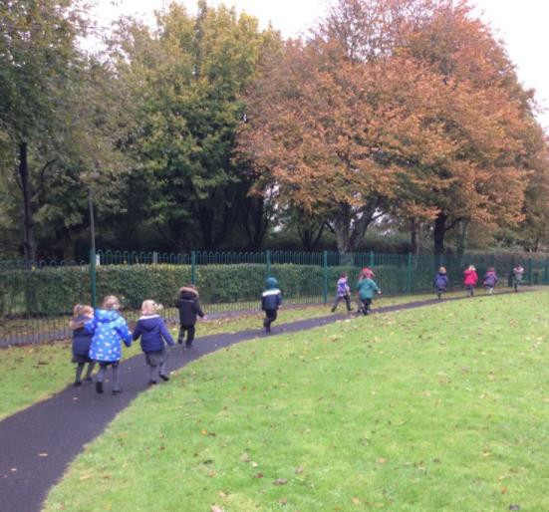
Track Time

Slide 8



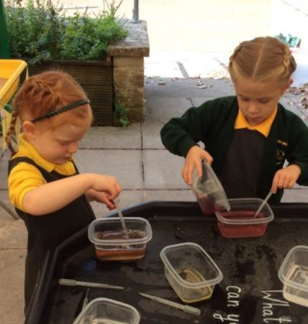
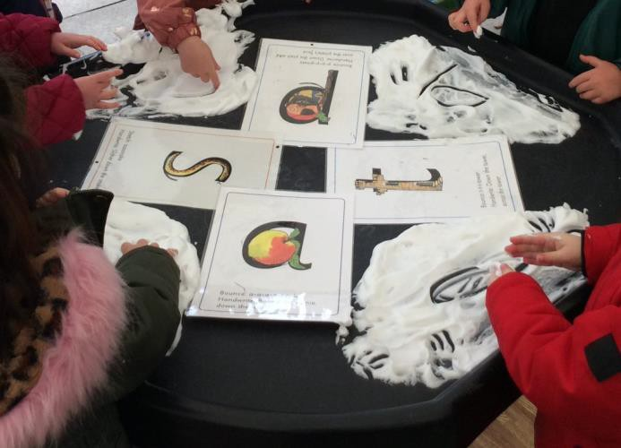
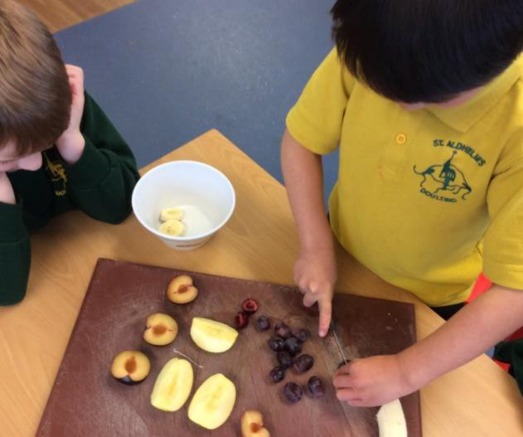

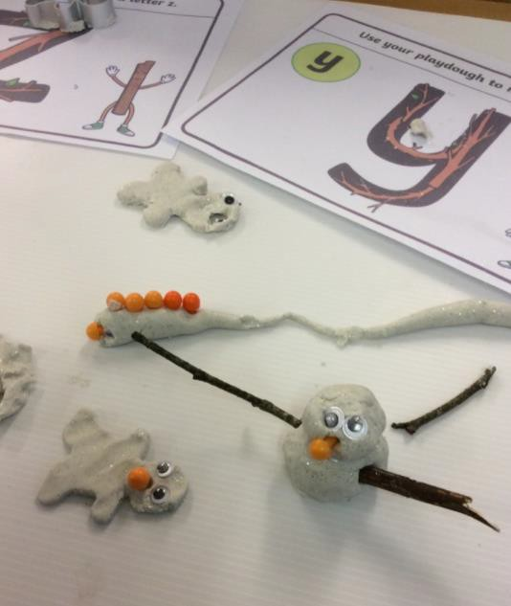

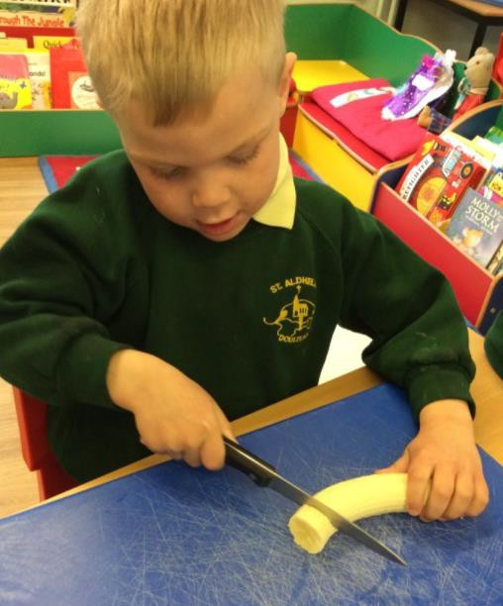

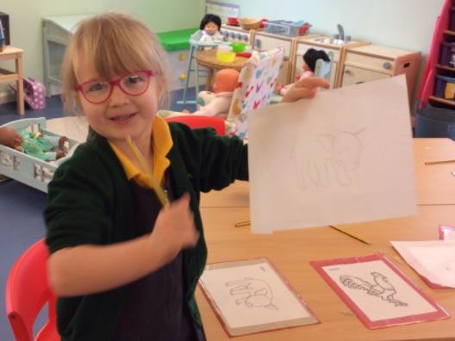
Fine Motor Skills

Slide 9



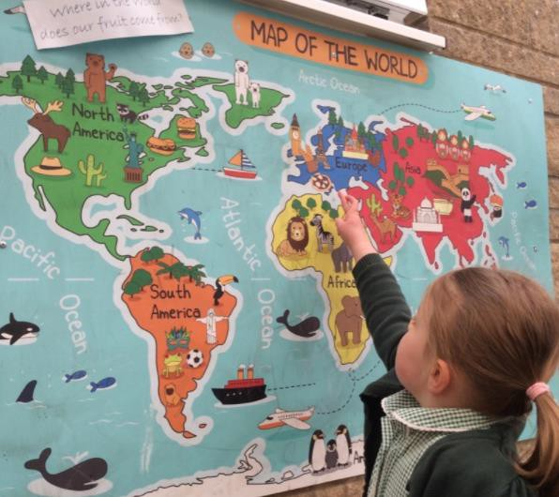

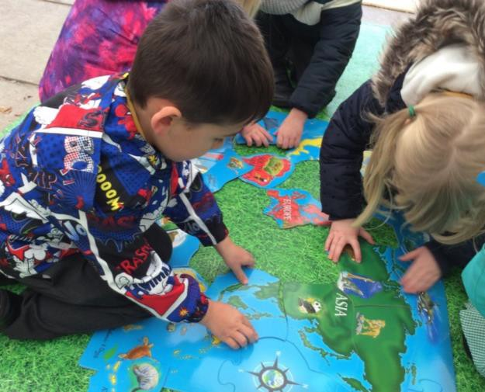
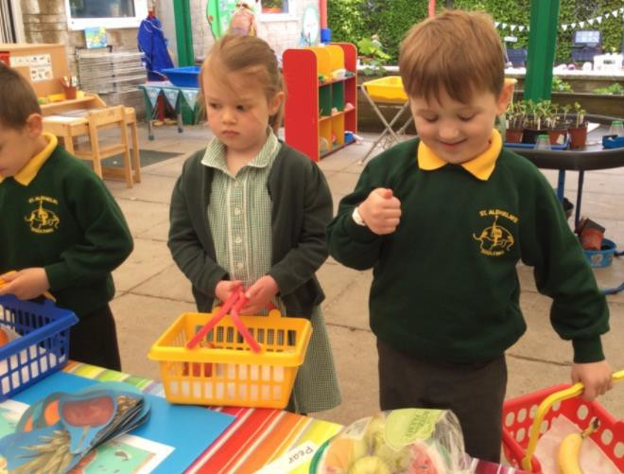


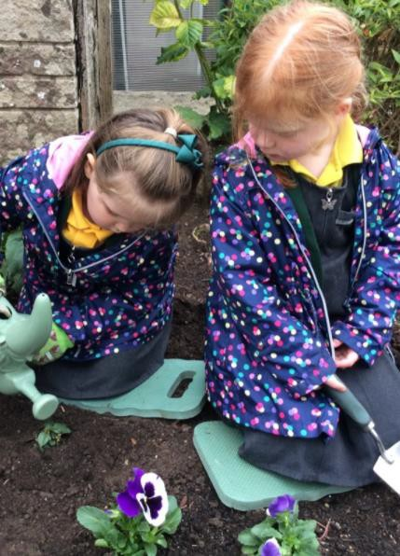

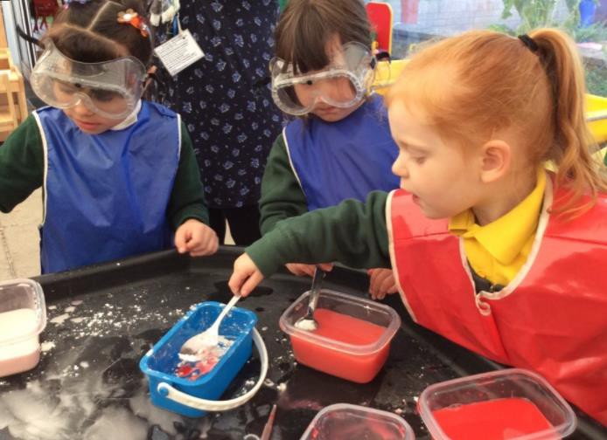
Understanding the World

Slide 10


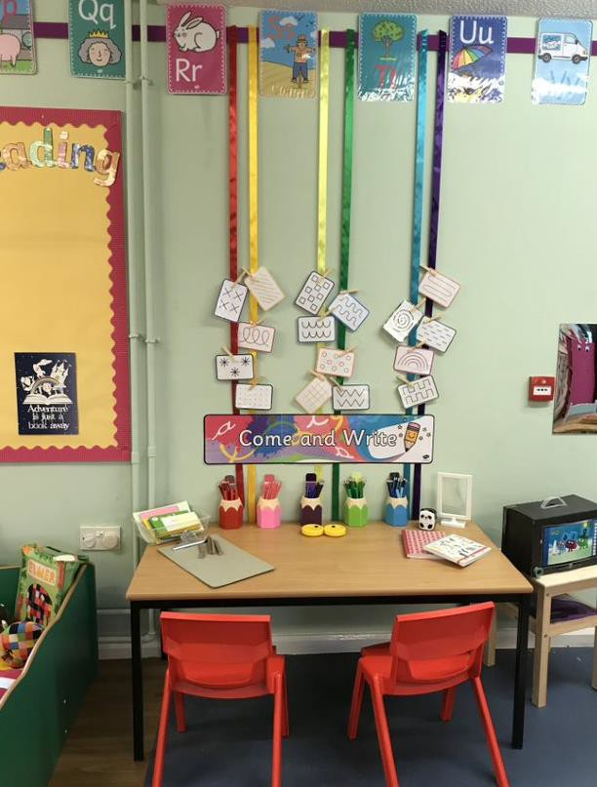
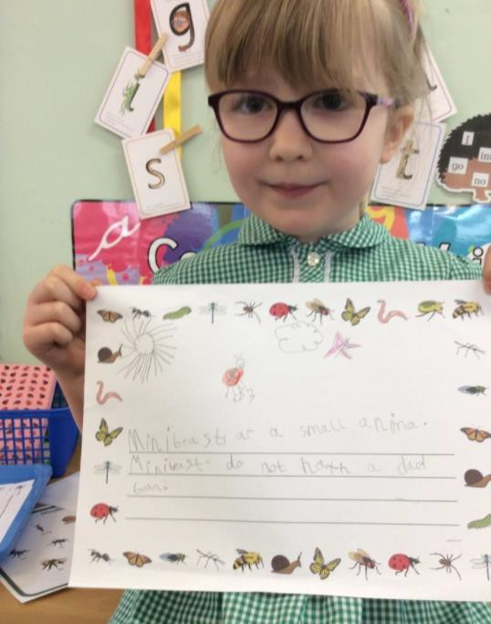

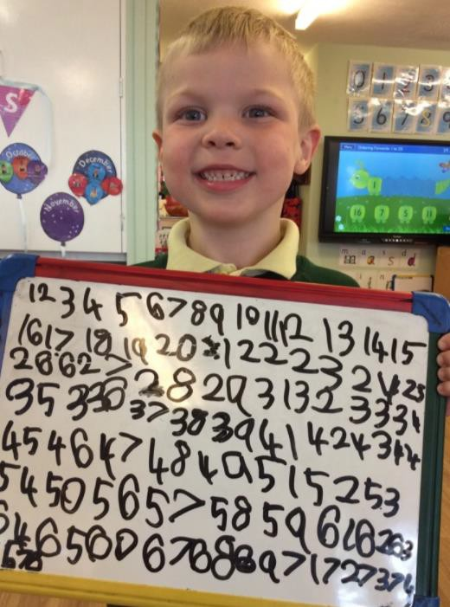

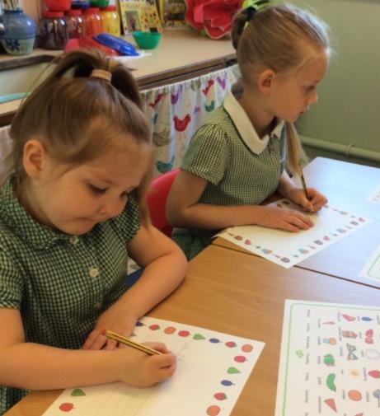

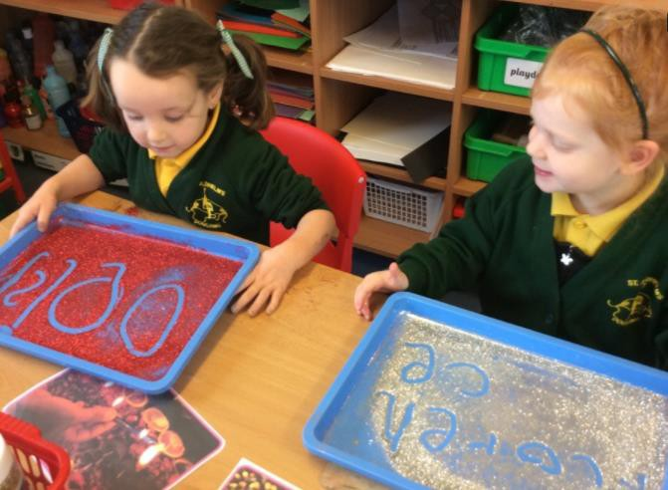

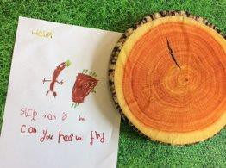
Writing

Slide 11


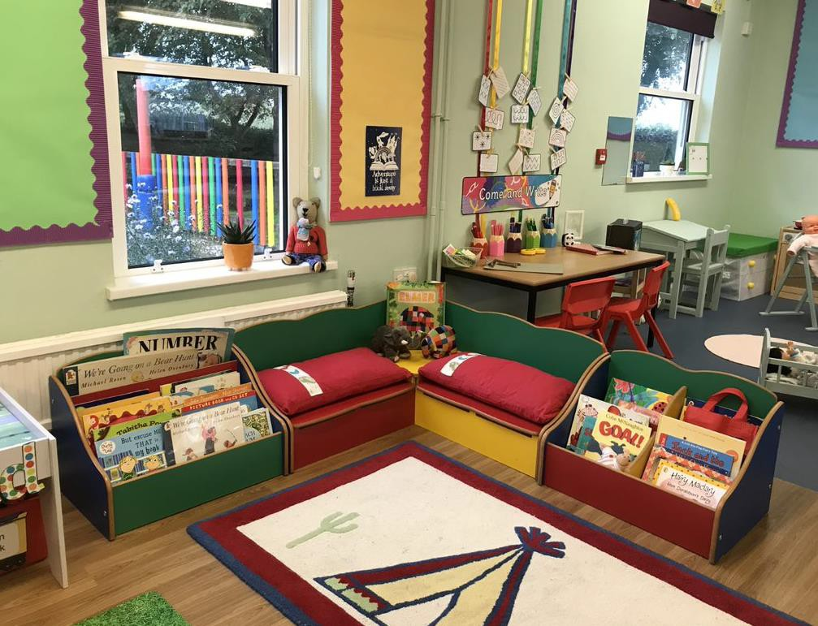


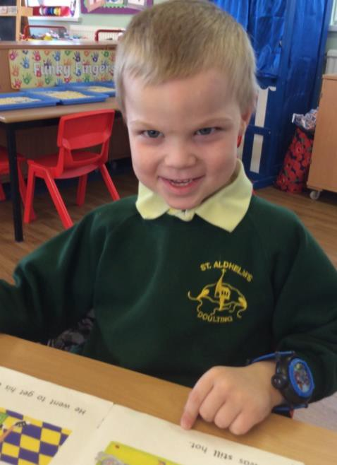


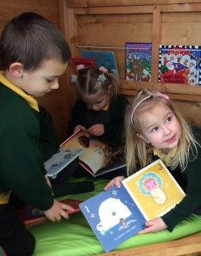

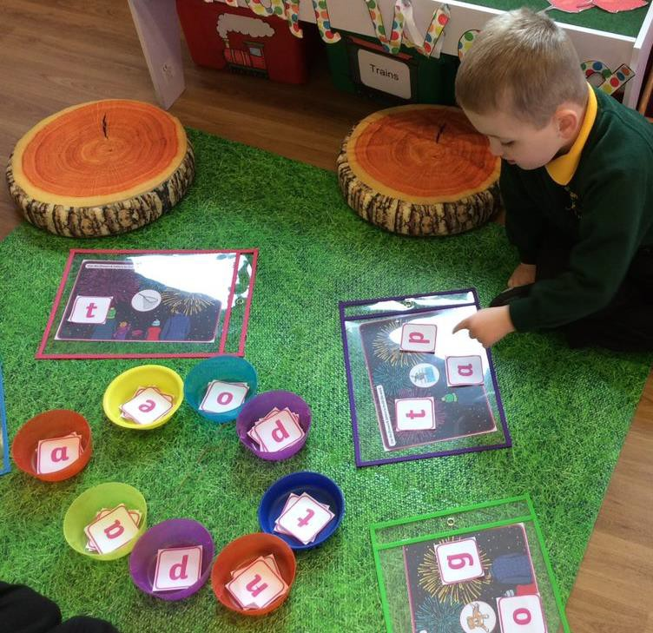
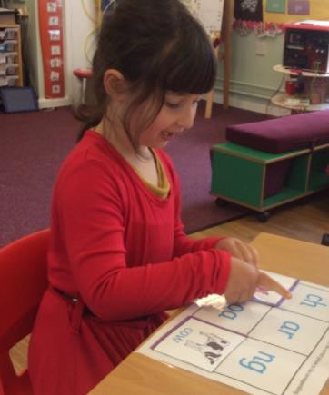
Phonics and Reading

Slide 12



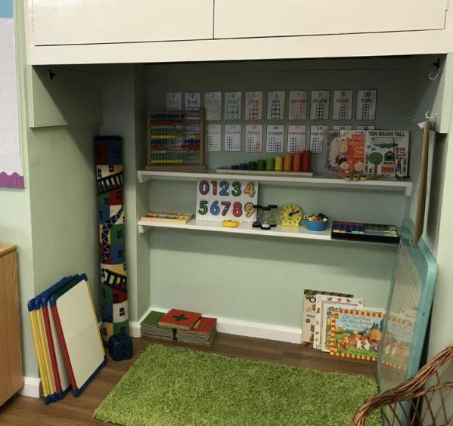
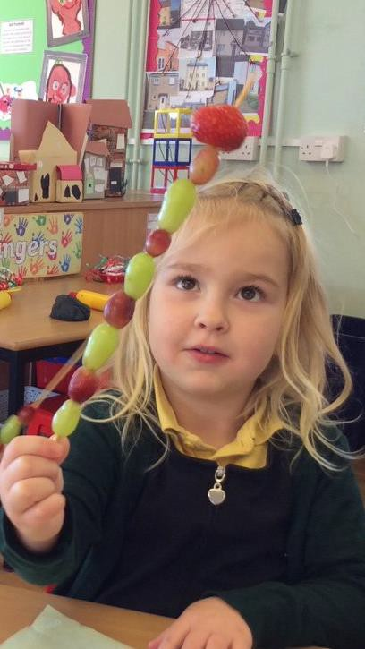
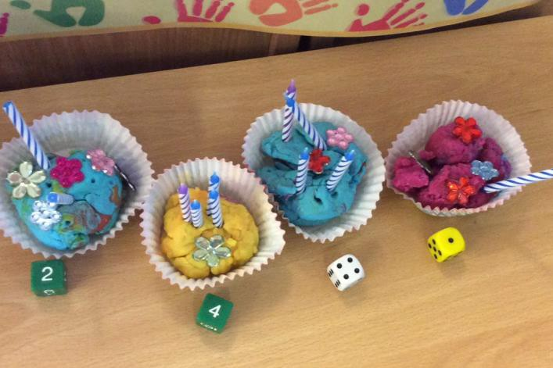


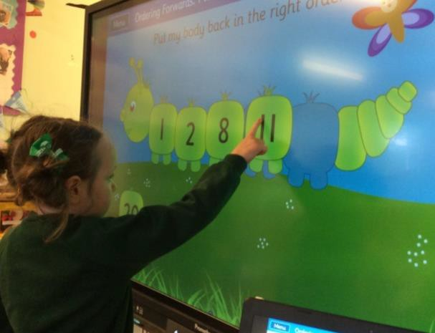
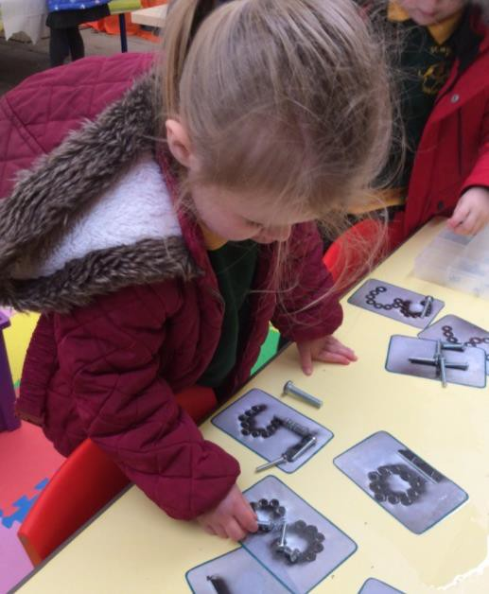


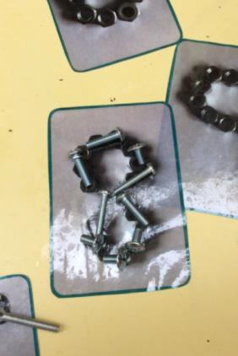
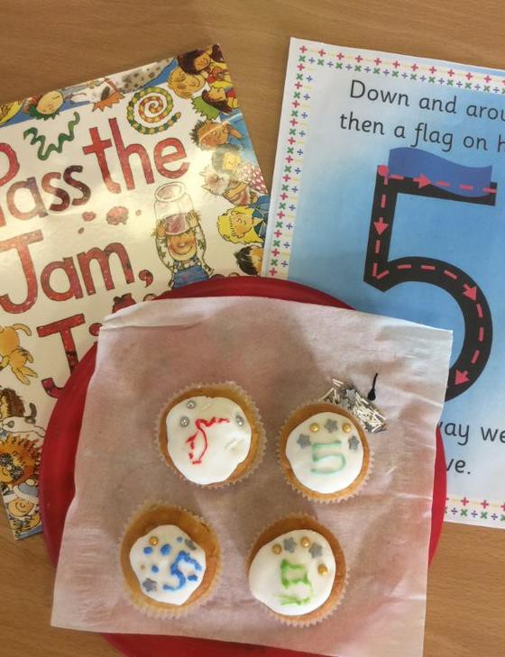
Mathematics

Slide 13



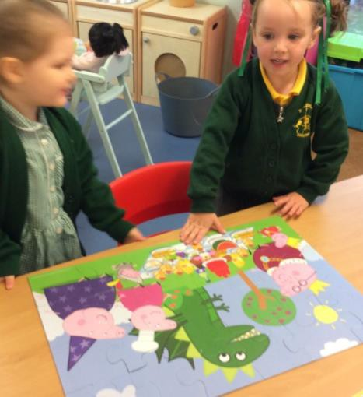
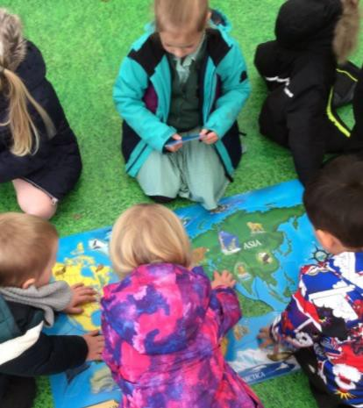
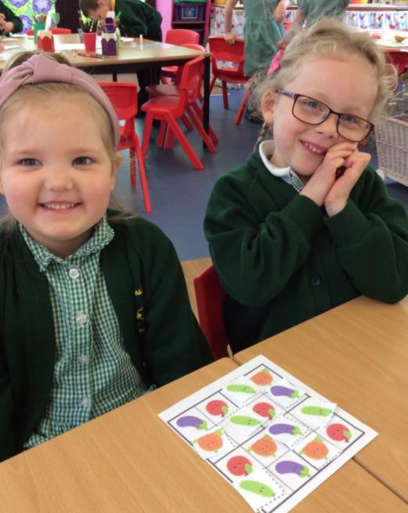








Spatial reasoning

Slide 14














Expressive Arts and Design

Slide 15












Expressive Arts and Design

Slide 16












Small World Play

Slide 17













Outdoor Learning

Slide 18



















Celebrations

Slide 19













Physical & Health and Self-Care

Slide 20














Music

Slide 21








Snack Times
Lunch Times

Slide 22












Role-play

Slide 23










Technology

Slide 24






Capturing your Child’s Learning and Progress
Tapestry is an on-line interactive learning log that we use to capture and record children’s learning and progress. It is a valuable communication tool between
home and school.
More information will follow about using Tapestry at home when your child starts school.

Slide 25
Welcome to St Aldhelm’s Booklet and Early Years Foundation Stage Policy
Our useful Welcome to St Aldhelm’s Booklet will provide lots of information and details about our school and preparing to start. We hope that this will answer lots of questions you may have or prompt some that you may like to ask.
The EYFS Policy provides the detail of what we do and how we do it. It shares how our whole school ethos and Christian values begin in the reception year and underpin all our learning. Both documents are attached in the email for you.
Learning together for life in all it’s fullness
~ John 10:10

Slide 26

‘My Transition Book’
‘My Transition Book’ has been created for you to share with your child. It has child friendly photographs of our school site, including the Reception Classroom, undercover and outside areas, as well as photographs of key adults that your child can start to get to know by name and sight. The book is on the following slides and is also attached as document should you wish to print and share with your child.

Slide 27



Slide 28



Slide 29


Slide 30


In Reception, we have an undercover learning area outside. This is where we do lots of activities including
play in the role ploy area.
Scooters and bikes
Mud Kitchen
Construction Area
Role Ploy Area
Sand and Water Trays
Reading Shed
Outdoor Art Area

Slide 31



School Visits for your child
We welcome your child into school in a smaller group of 11, on Wednesday 21st and 28th June. They will be able to meet the Reception Staff Team, as well as explore the Early Years Provision – playground, undercover area and classroom. Details of the timings for these sessions are also shared today.

Slide 32

Wednesday 5th July at 1.45pm
Teddy Bears Picnic
We would like to invite you and your child to a Teddy Bears Picnic. Please bring
a picnic, picnic blanket and a teddy!
This opportunity will be held outside and will give you a chance to meet the
Reception Staff Team and other school staff, in person.
There will be a chance to find out about our 'wrap around care' facilities and have a chance to ask any questions.
You will also have the chance to discuss any queries around the induction
documents that will be sent to you electronically.

Slide 33



Phased entry into school
Children begin their phased start in September, with children entering in smaller groups. This normally takes place over three weeks, with children attending for mornings or afternoons, then with lunch before staying at school full-time.

Slide 34

We hope that you have enjoyed the presentation and the information has been helpful for you and your child.
We look forward to meeting you soon!
From
Mrs Cohen
Headteacher
Mrs Scott and Mrs Palmer
Reception Class Teachers

