Slide 1

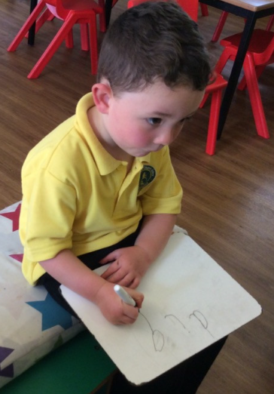
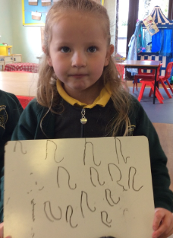
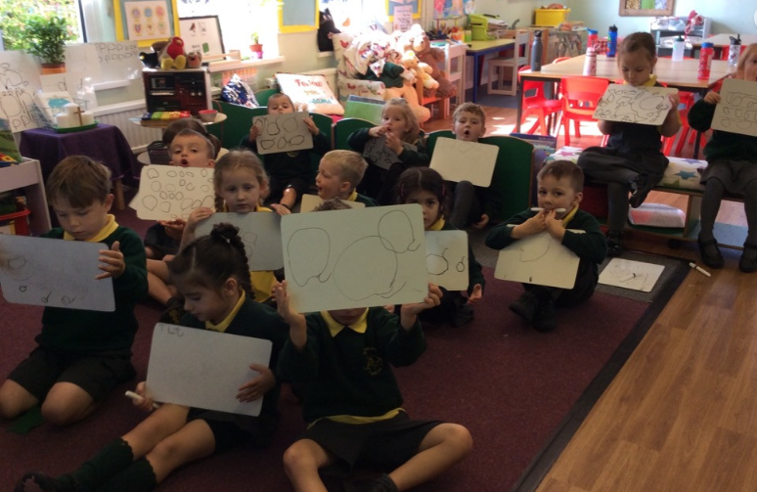
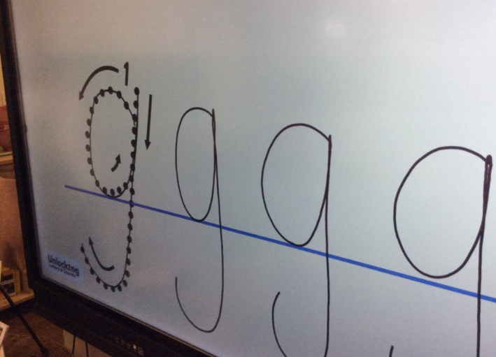
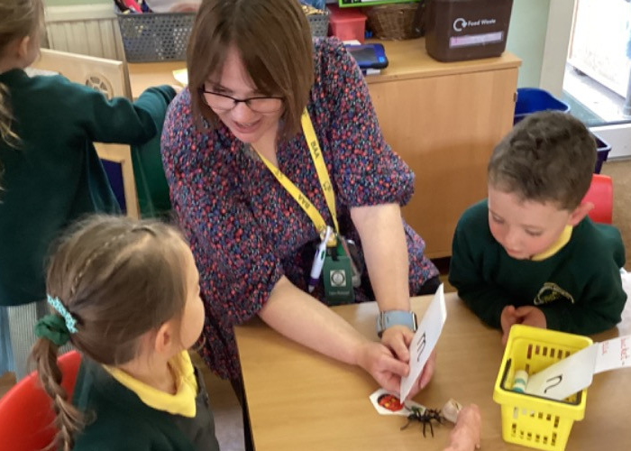
Welcome to
St Aldhelm’s VA Church
Primary School
Phonics and Reading Meeting – Tuesday 24th September 2024

Slide 2


Phonics and reading
Phonics - Phonics is a way of teaching reading, writing and spelling based on hearing and identifying letter sounds and matching them to the letters or letter patterns.
Grapheme – A grapheme is a letter or sequence of letters that represent a phoneme (one sound). When we read aloud, we decode written words by converting graphemes into phonemes.
Phoneme – A phoneme is a single spoken sound, e.g. /c/ as in c-a-t, or /sh/ as in sh-i-p.
Digraph – A digraph is a single sound (i.e. a phoneme) that is made up of two letters, e.g. ee as in t-r-ee or ie as in t-ie
Trigraph – A trigraph is a single sound (a phoneme) that is made up of three letters, e.g. igh as in high

Slide 3
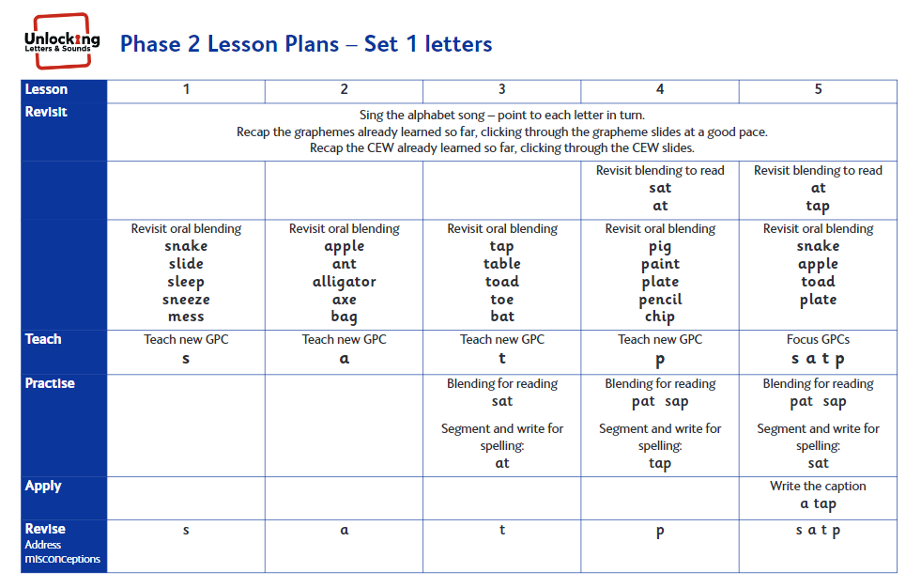
How do we teach phonics?
Unlocking Letters & Sounds
Format of each phonics session stays the same:
Sing the alphabet song.
Recap the graphemes already learned so far.
Revisit blending to read
Revisit oral blending
Teach new GPC
Recap the Common exception words (CEW) already learned so far.
Teach new CEW
Practise blending for reading
Segment and write for spelling
Apply: Write or read a caption
Revise new GPCs – Address any misconceptions

Slide 4
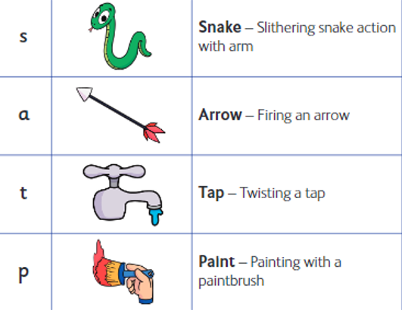
Phase 2 Graphemes
Phase 2

Slide 5
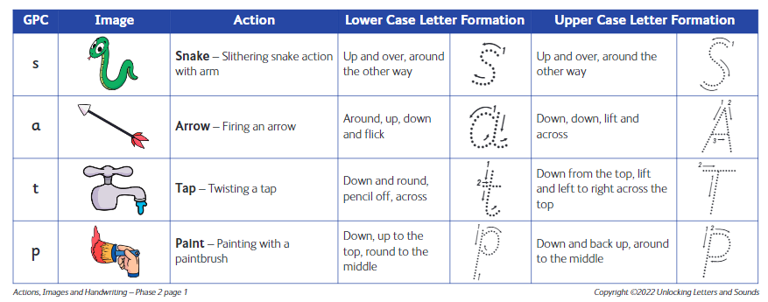

Slide 6
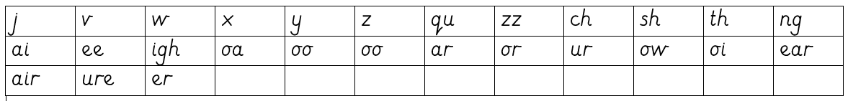
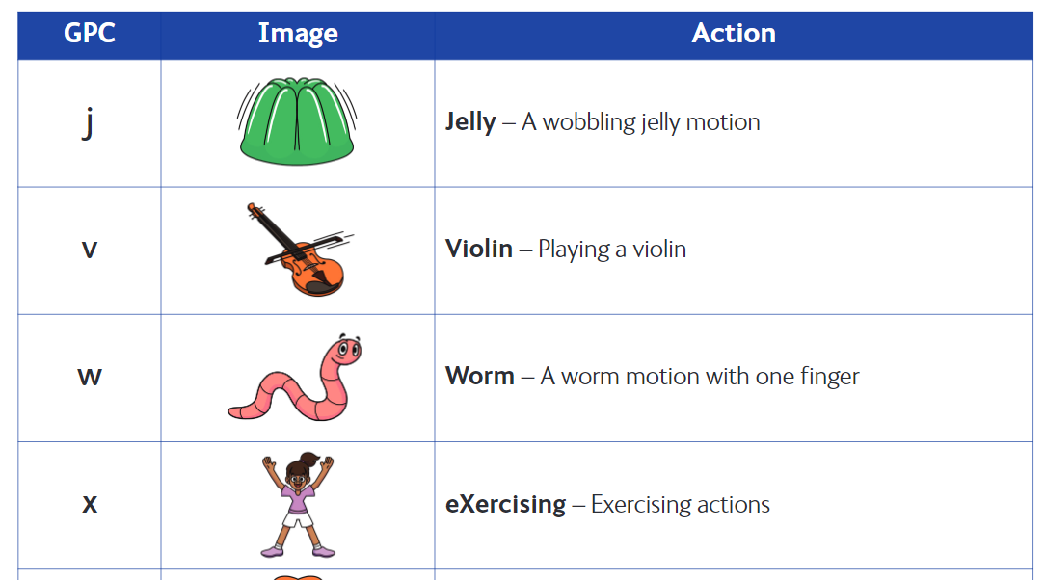
Phase 3 Graphemes
Phase 3

Slide 7
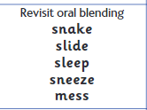
Oral Blending

Slide 8

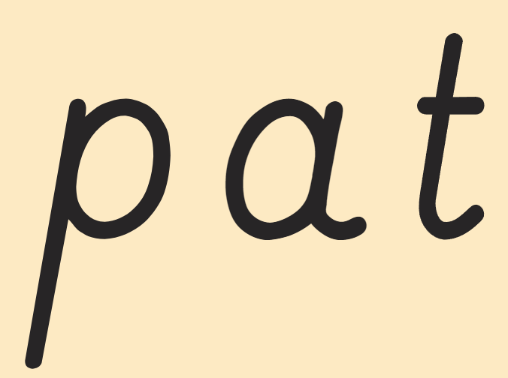
Blending
Sound buttons

Slide 9

Segmenting for spelling
“Segment the word listening to all of those phonemes writing the corresponding graphemes.”
Stretch out the word
Phoneme fingers

Slide 10
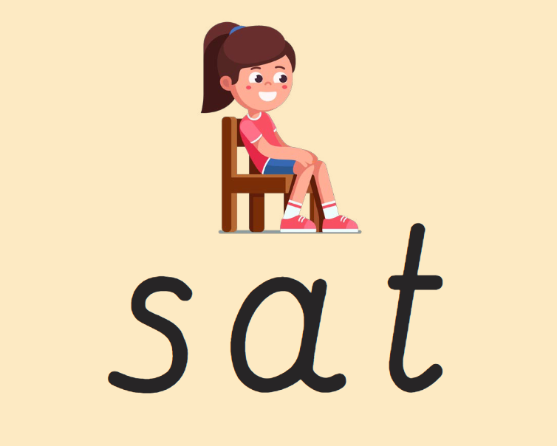
Segmenting for spelling

Slide 11

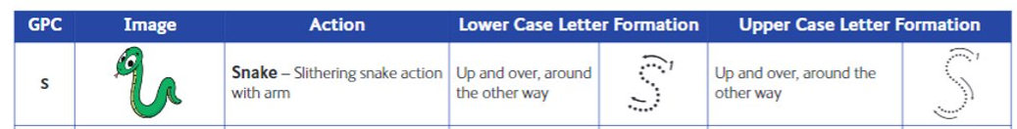

How can you support at home?
Grapheme Cards – Four new grapheme cards will be added to your child's treasury tag each week. You can use these as flash cards to practice saying the phonemes, to play games such as hide and find the phoneme, to begin to build VC and CVC words to blend to read or segment to spell.
The GPC (grapheme phoneme correspondence), action and handwriting ditty will be added to tapestry daily. The children will teach you!
“I am going to show you the grapheme and I would like you to tell me the phoneme.”

Slide 12
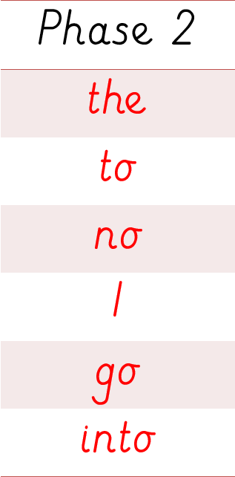
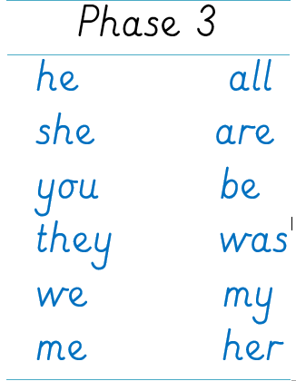
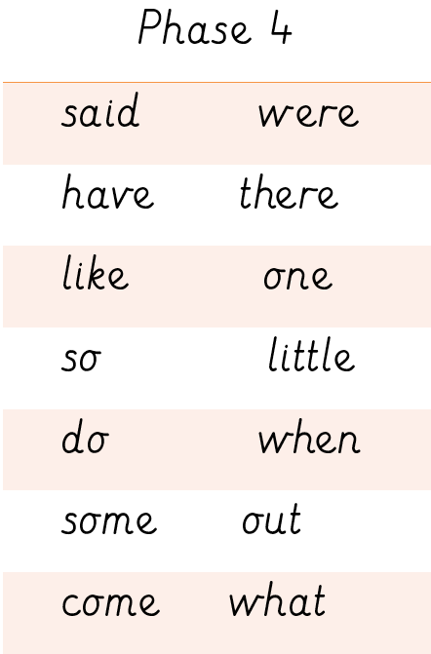
Common exception words

Slide 13





Common exception words
The children will be taught the common exception words in a particular order. The children will bring home a common exception word card to learn focussing on words from each phase.

Slide 14

Reading Books
The children will bring home one decodable phonics reading book and one sharing book per week. The children will choose a sharing book from the library. The decodable books should be read by your child and the sharing books read by an adult to your child. This means your child will have the opportunity to develop their decoding skills, build their fluency and expand their vocabulary and knowledge of stories beyond their own reading level. Please support in reading with your child four times a week. Please comment and initial to let us know when your child has read and how they have got on.

Slide 15
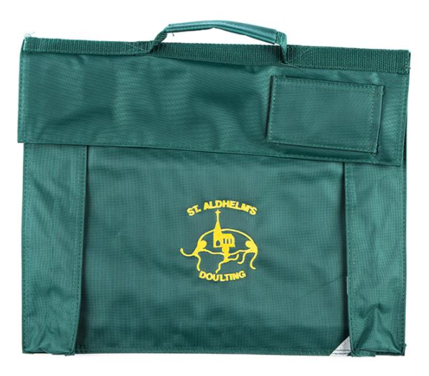
Book bags
Useful for Reading Books, other Home learning books and Letters
Personal Keyring
No Water bottles

Slide 16

?
?
?
Any questions?
?
?
?

