Slide 1
KS1 Phonics and Reading

Slide 2
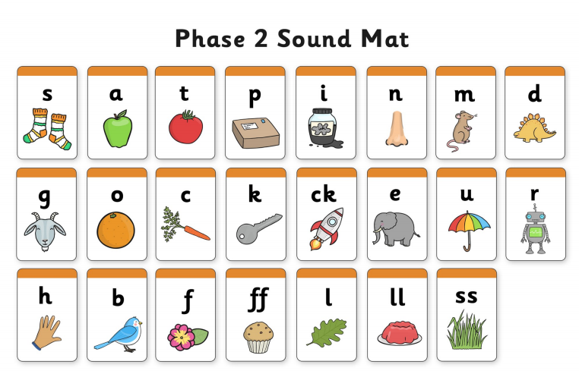

Slide 3
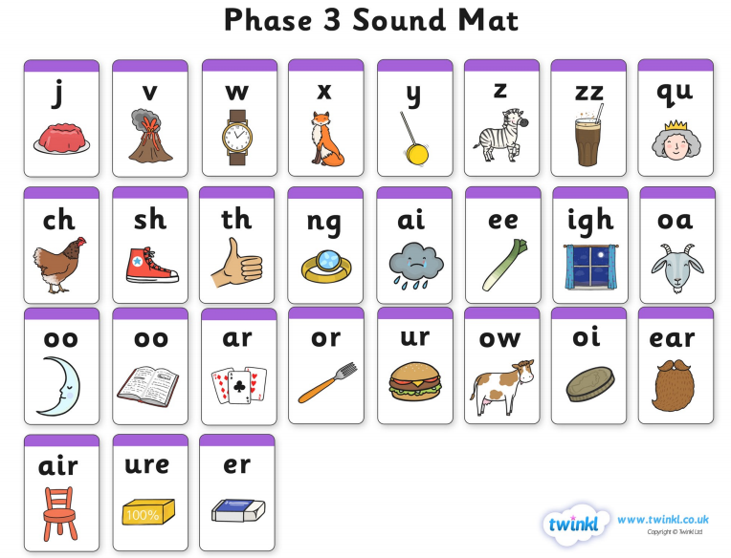

Slide 4
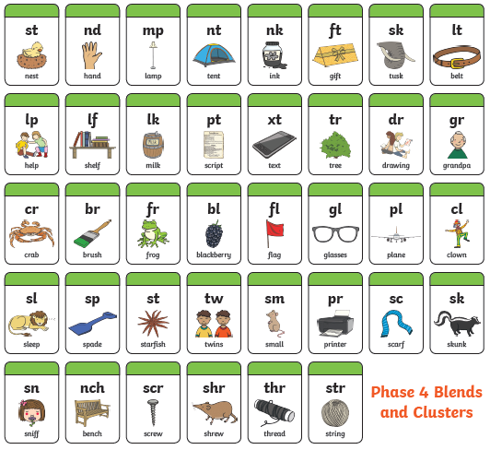

Slide 5
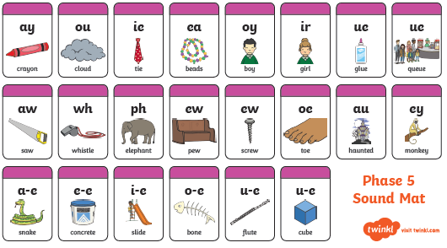

Slide 6
Reading
As well as hearing your child read, please ask a range of questions to help them develop their reading skills.
Over the next few slides, you will see examples of how to do this.

Slide 7
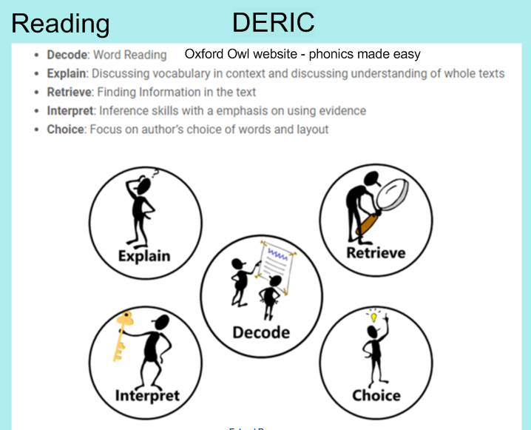

Slide 8
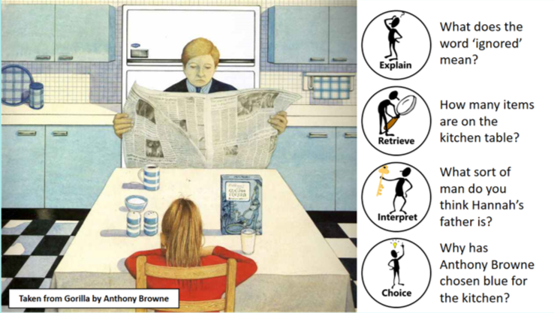
Example of DERIC in action..

Slide 9

There are lots of ways to enjoy reading at home..

Slide 10
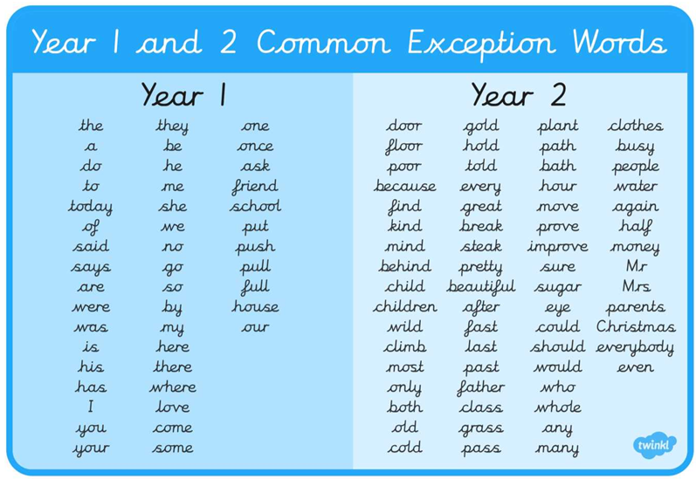
Spelling – common exception words. Can you spot any of these while you are reading?

